Slide 1
Mass Storage Management

Slide 2
Overview of Mass Storage Structure
Magnetic disks provide bulk of secondary storage of modern computers
Drives rotate at 60 to 250 times per second
Disks can be removable
Drive attached to computer via I/O bus
Busses vary, including EIDE, ATA, SATA, USB, Fibre Channel, SCSI, SAS, Firewire
Host controller in computer uses bus to talk to disk controller built into drive or storage array

Slide 3
Moving-head Disk Mechanism

Slide 4
Disk Structure
Disk drives are addressed as large 1-dimensional arrays of logical blocks, where the logical block is the smallest unit of transfer.
The 1-dimensional array of logical blocks is mapped into the sectors of the disk sequentially.
Sector 0 is the first sector of the first track on the outermost cylinder.
Mapping proceeds in order through that track, then the rest of the tracks in that cylinder, and then through the rest of the cylinders from outermost to innermost.

Slide 5
The read/write data is a three-stage process:
Position the head/arm over the proper track (into proper cylinder). The time required to move the heads from one cylinder to another, and for the heads to settle down after the move is called as Seek time/Positioning time (random-access time).
Wait for the desired sector to rotate under the read/write head. The amount of time required for the desired sector to rotate around and come under the read-write head is referred as Rotational latency.
Transfer a block of bits (sector) under the read-write head. The time required to move the data electronically from the disk to the computer is called Transfer time.

Slide 6
The disk access time is computed as follows:
Seek Time: Ts = m* n + s
where n is the number of tracks traversed, m is the track traversal time and s is the startup time
Rotational Latency: T_{R} = 1/ (2 * r)
where r is the number of revolutions per time unit
Transfer Time: T_{T} = b/ (r * N)
where b is the number of bytes to be transferred and N is the number of bytes on track
Disk Access Time: T = T_{S} + T_{R} + T_{T}
Disk bandwidth is the total number of bytes transferred divided by the total time between the first request for service and the completion of the last transfer.

Slide 7
Magnetic Tape Storage:
It is sequential access storage and it is both persistent and rewritable. This device is not suitable for transaction processing where random (direct) access is used for accessing data. Also the access time is very slow. These are used mostly for back up purposes.
Disk Storage:
These are random access devices and the storage capacity varies from megabytes to terabytes. These devices exhibit variable access speed that depends on the relative positions of the read-write head and the requested data. Some examples of disks are magnetic disks, magneto-optical disks, floppies and CDs.

Slide 8
Disk Attachments
Disk drives can be attached either directly to a particular host machine or to a network.
Host-Attached Storage
The storage is referred as Local disk and accessed through I/O Ports. The most common interfaces are IDE or ATA, each of which allow up to two drives per host controller.
Network-Attached Storage
The storage devices are part of a LAN/WAN and are accesses by the clients using Remote Procedure Call (RPC) typically with NFS file system mounting. These devices form a shared storage by using naming conventions and allow group access by the clients.

Slide 9
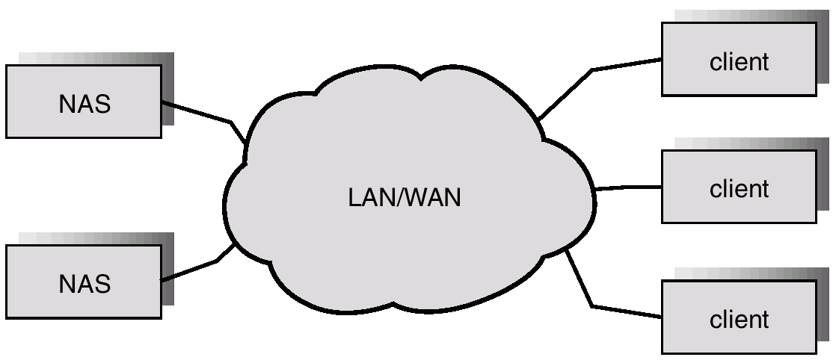

Slide 10
Storage-Area Network
A Storage-Area Network (SAN) connects computers and storage devices in a network, using storage protocols instead of network protocols.
It is very flexible and dynamic, allowing hosts and devices to attach and detach on the fly and is also controllable allowing restricted access to certain hosts and devices.

Slide 11
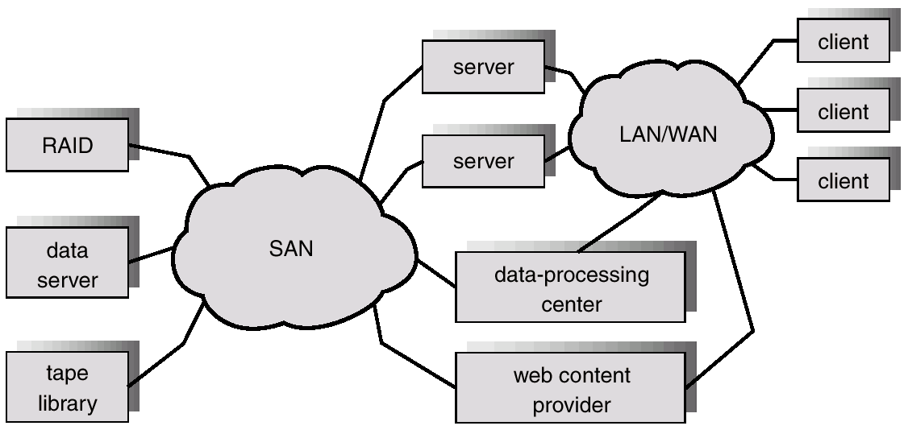

Slide 12
Disk Scheduling

Slide 13
Disk Queues
Each disk has a queue of jobs waiting to access disk
read jobs
write jobs
Each entry in queue contains the following
pointer to memory location to read/write from/to
sector number to access
pointer to next job in the queue
OS usually maintains this queue

Slide 14
Disk Queues
Entry 3
Entry 2
Entry 1
Sector Z
Mem Ptr 2
next entry
Sector Y
Mem Ptr 1
next entry
Sector X
Mem Ptr 0
next entry
head
tail
Disk

Slide 15
Disk Scheduling
Several algorithms exist to schedule the servicing of disk I/O requests.
Example
A request queue is (0-199).
98, 183, 37, 122, 14, 124, 65, 67
Head pointer 53

Slide 16
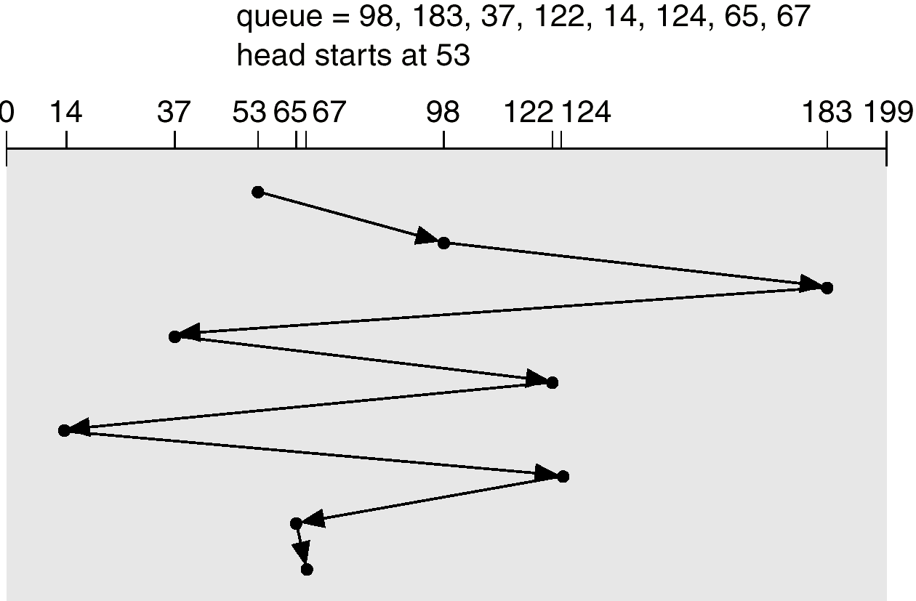
FCFS
Illustration shows total head movement of 640 cylinders.

Slide 17
SSTF
Selects the request with the minimum seek time from the current head position.
SSTF scheduling is a form of SJF scheduling; may cause starvation of some requests.
total head movement of 236 cylinders.

Slide 18
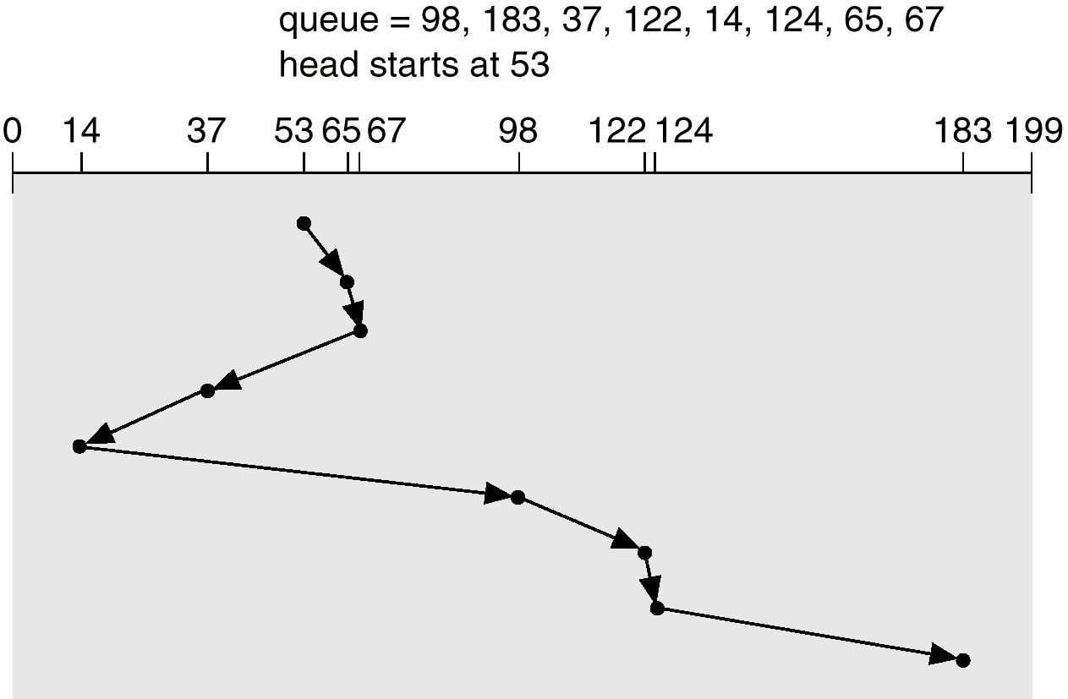
SSTF

Slide 19
SCAN
The disk arm starts at one end of the disk, and moves toward the other end, servicing requests until it gets to the other end of the disk, where the head movement is reversed and servicing continues.
Sometimes called the elevator algorithm.
total head movement of 208 cylinders.

Slide 20
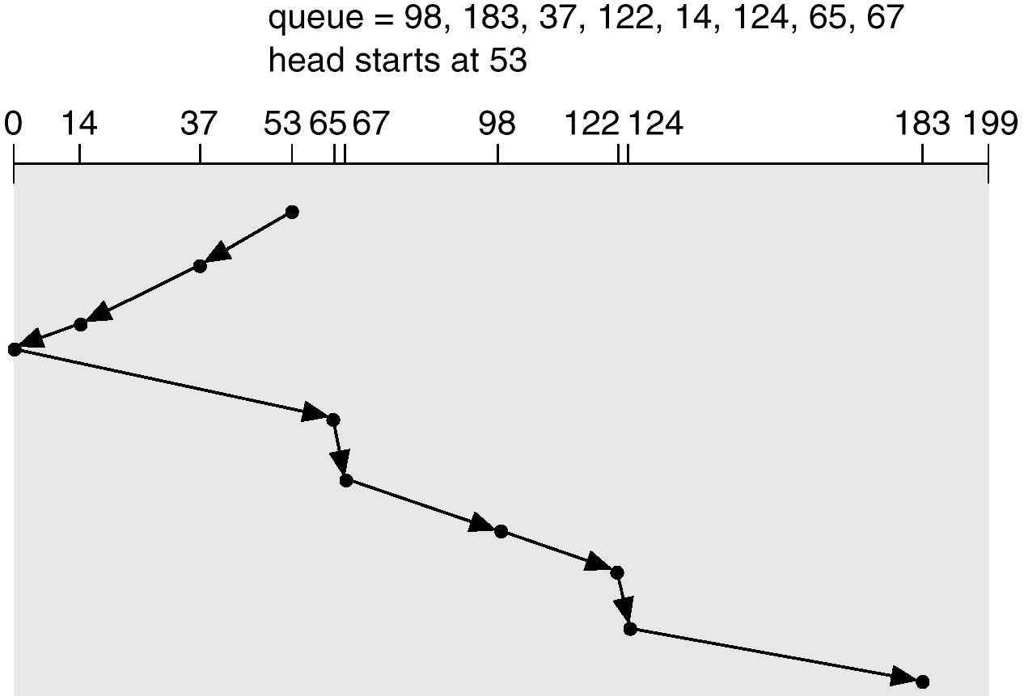
SCAN

Slide 21
Circular SCAN (C-SCAN)
Provides a more uniform wait time than SCAN.
The head moves from one end of the disk to the other. servicing requests as it goes. When it reaches the other end, however, it immediately returns to the beginning of the disk, without servicing any requests on the return trip.
Treats the cylinders as a circular list that wraps around from the last cylinder to the first one.

Slide 22
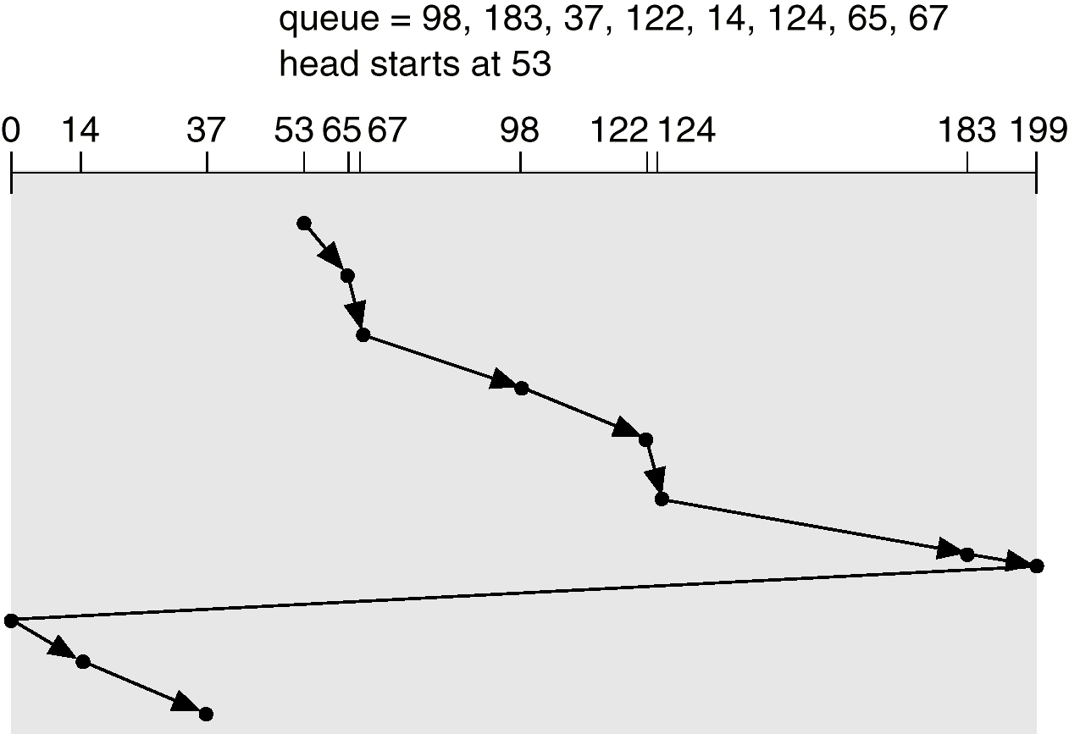
C-SCAN

Slide 23
LOOK
The head moves in one direction and satisfies the request in that direction, if there is no request in that direction, it reverses its direction and serves request

Slide 24
C-LOOK
Version of C-SCAN
Arm only goes as far as the last request in each direction, then reverses direction immediately, without first going all the way to the end of the disk.

Slide 25
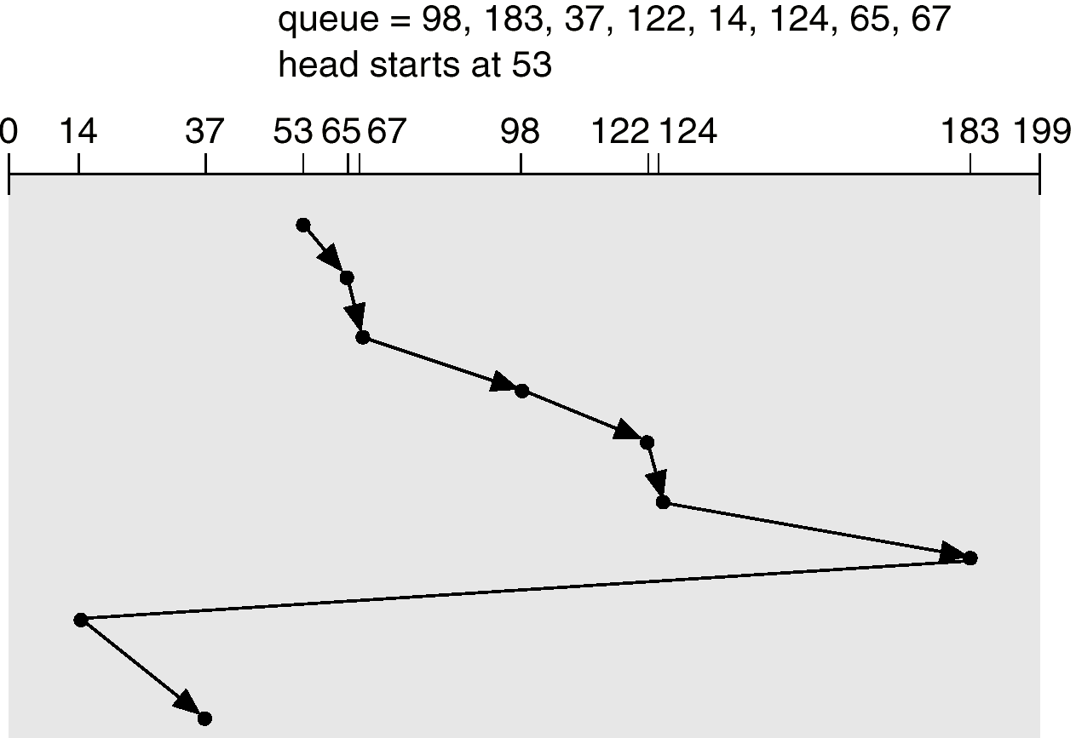
C-LOOK

Slide 26
Selecting a Disk-Scheduling Algorithm
SSTF is common and has a natural appeal
SCAN and C-SCAN perform better for systems that place a heavy load on the disk.
Performance depends on the number and types of requests.
Requests for disk service can be influenced by the file-allocation method.
The disk-scheduling algorithm should be written as a separate module of the operating system, allowing it to be replaced with a different algorithm if necessary.
Either SSTF or LOOK is a reasonable choice for the default algorithm.

Slide 27
Redundant Array of Inexpensive/Independent Disks (RAID)
Secondary storage devices are slow and to improve their performance multiple devices in parallel such as arrays of disks are used.
RAID is a group of hard drives together with some form of redundancy is employed to improve the performance and to provide reliability.
Single large capacity disk is replaced with array of smaller capacity disks.
Earlier small cheaper disks were used so it was inexpensive but now large expensive disks are used so it is independent.

Slide 28
Common characteristics:
Array of physical disks are visible as single device to OS.
Data is distributed across physical drives of array.
Redundant disk capacity is used for error detection/correction.
Benefits:
Improved I/O performance; Enables incremental upgrade
Problem:
Reliability is achieved through more devices that increase the probability of failure and the solution is redundancy.

Slide 29
RAID is arranged into six different levels.
Several improvements in disk-use techniques involve the use of multiple disks working cooperatively.
Disk striping uses a group of disks as one storage unit.
RAID schemes improve performance and improve the reliability of the storage system by storing redundant data.
Mirroring or shadowing keeps duplicate of each disk.
Block interleaved parity uses much less redundancy.

Slide 30
Bit level and block level striping

Slide 31
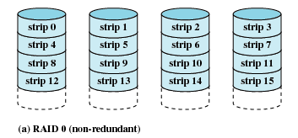
RAID 0 (non-redundant)
Block level striped set without Parity
RAID 0 offers no redundancy, but improves disk access
Here, files are broken into strips and distributed across disk surfaces (known as disk spanning) so that access to a single file can be done in parallel disk accesses

Slide 32
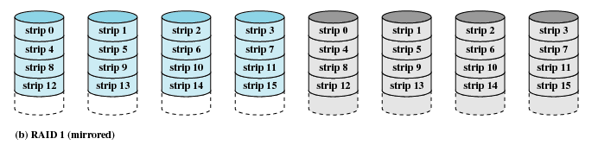
RAID 1 (mirrored)
Mirrored set without parity
100 percent redundancy leads to increase in cost.
Read operation is done with multithreading and split reads. There is small penalty in write operation because of redundancy (writes require saving to both sets of disk).

Slide 33
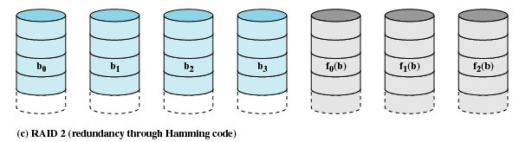
RAID 2 (redundancy through Hamming code)
Memory style error correcting parity
Head and spindles are synchronized.
Strips are small.
It strips each byte into 1 bit per disk and uses additional disks to store Hamming codes for redundancy
Error correction codes are corrected over bits of data disks.
It is suitable for system with many failures.

Slide 34
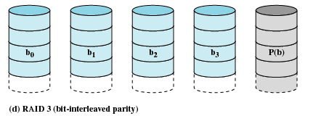
RAID 3 (bit-interleaved parity)
Bit interleaved Parity Head and spindles are synchronized.
Strips are small.
Simple parity bits are used instead of Error correcting codes.
most suitable for small computer systems that require some but not total redundancy

Slide 35
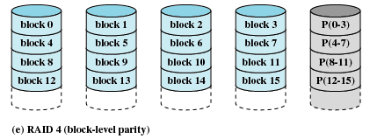
RAID 4 (block-level parity)
Block Level Parity ; Same as RAID 3 but with block level striping
Disks are not synchronized
Strips are large and each strip contains parity information of all corresponding strips
All parity information is placed on a single disk which creates a bottleneck and so defeats the advantage of parallel accesses

Slide 36
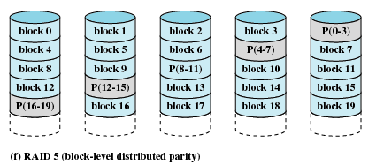
RAID 5 (block-level distributed parity)
Striped Set with Interleaved parity
Same as RAID 4 but parity spread across all disks
Disks are not synchronized
Strips are large strips

Slide 37
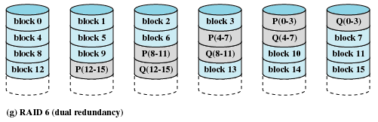
RAID 6 (dual redundancy)
Striped Set with Dual Interleaved Parity
Same as RAID 5 but uses 2 bits for storing parity
Disks are not synchronized
Strips are large
ECC is used instead of parity
Tolerates two failures

